Slide 1


MAPPING THE EDUCATIONAL LANDSCAPE
Presented by:
Jay kumar

Slide 2
Project Objective:-
The objective of the “Data analytics Of College Analysis” project is to perform a comprehensive analysis of the features, ratings, and reviews of colleges listed on the college360 platform across India.
By analyzing the data, this project aims to uncover student preferences, regional fee variations, and the growing demand for specific courses. The insights are designed to optimize institutional strategies, enhance marketing efforts, and improve the overall competitiveness of colleges in the Indian education ecosystem.
The data was sourced from the college360 website using Python-based web scraping techniques, extracting detailed datasets for analysis.

Slide 3
Main Agenda
1)Web Scrapping to collect the data
2. Data Cleaning and Manipulation
3. Visualization and Analysis on various factors like Fees, Location, Reviews, Courses, and Ratings to address key educational trends and student preferences.
An in-depth exploration of web scraping and data visualization using Python on the "GetMyUni" website, focusing on retrieving data from colleges across India. This project highlights the power of extracting, analyzing, and visualizing data to provide actionable insights into the Indian higher education landscape.

Slide 4
Tools used:-
Software Requirement:-
1)Python(jupyter notebook)
2)Power bi
3)Excel
Main Software Libraries:-
1)Pandas
2)Numpy
3)Beautiful Soups
4)Requests
5)CSV
4)Tableau

Slide 5

INTRODUCTION:-
Overview of project:-
This project focuses on analyzing engineering college data through web scraping, data cleaning, modeling, and preprocessing using Python, followed by data visualization in Tableau.
Importance of Analyzing Engineering College Data:-
Understanding engineering college data is critical to identifying trends, analyzing fee structures, student preferences, course popularity, and regional variations.
Importance of web scraping and data preprocessing and data visualization:-
Visualization tools like Tableau make complex datasets easier to understand and communicate, enabling data-driven decision-making.

Slide 6
Webscrapping:-
Step 1:- IMPORT LIBRARIES
import csv # CSV file handling
import requests # HTTP requests :-web scraping or interacting with web
import pandas as pd # Data manipulation using pandas.
from bs4 import Beautiful Soup # HTML parsing using Beautifulsoup :-pulling data out of HTML and XML files and searching and modifying phrase tree

Slide 7
.
STEP 2:- URL
Web url = "https://engineering.careers360.com/colleges/ranking?page=1&icn=engineering-ranking_landing-page&ici=data-section_c360-home&sort_by=1&stream=1"
STEP 3:- CHECKING THE ACCESS OF URL
headers = {
"User-Agent": "Mozilla/5.0 (Windows NT 10.0; Win64; x64) AppleWebKit/537.36 (KHTML, like Gecko) Chrome/96.0.4664.110 Safari/537.36",
"Referer": url,
}
try:
# send a Get request with the defined headers
res = req.get(url, headers=headers)

Slide 8
.
# Check if the request was successful (status code 200)
if res.status_code == 200:
print("Access Granted. Status Code:", res.status_com
else:
print("unexpected Status Code:", resp.status_code)
except requests.exceptions.RequestException as e:
print("Error:",e)

Slide 9
.
STEP 4:- Requests and beautiful soup
response = req.get(url,headers = headers)
soup = BeautifulSoup(response.content,"html.parser")
STEP 5:- column names and extracting data through classes
collage_name = soup.find_all("h3",class_ = "college_name")
Own = soup.find_all("div" , class_="content_block d-block d-md-none")
Ranks = soup.find_all("div",class_ = "align-center")
ul = soup.find_all("ul",class_ = "snippet_list")
STEP 6:- Take empty lists
college_name = []
Own = []
Rank = []
Courses = []
Fees = []

Slide 10
.
STEP 7:- Append them in for loop
for college,ownership,ranks,course in zip(collage_name,O,Ranks,ul):
college_name.append(college.text.strip())
Own.append(ownership.text.strip())
#Rank.append(extract_rank(ranks.text.strip()))
Rank.append(extract_rank(ranks.text.strip()))
Courses.append(course.text.strip())
Fees.append(extract_fees(course.text.strip()))
STEP 8:- converting them into Dictionary
Data = pd.DataFrame({"NIRF_Rank":Rank,"College": college_name,"Ownership":Own,"Courses":Courses,"FEE":Fees})
print(Data)

Slide 11
.
STEP 9:- dictionary to data frames
#converting dictionary into a data frames
#creating csv file
Data = pd.DataFrame({"NIRF_Rank":Rank,"College": college_name,"Ownership":Own,"Courses":Courses,"FEE":Fees})
Data.to_csv("Karnataka.csv")

Slide 12
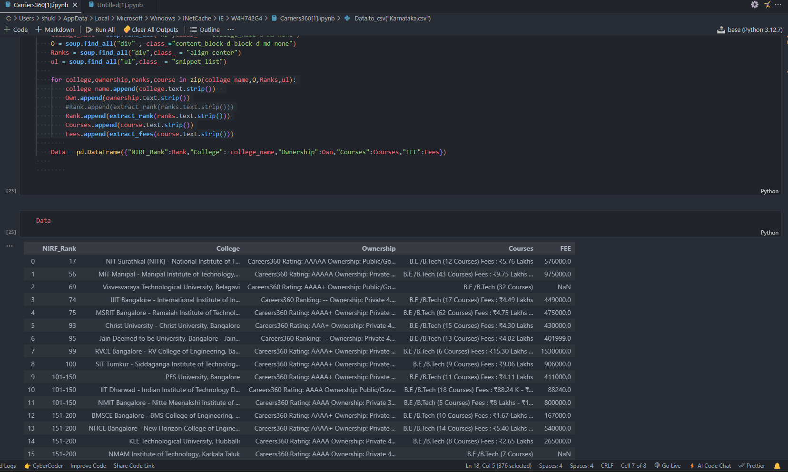
Output:-

Slide 13
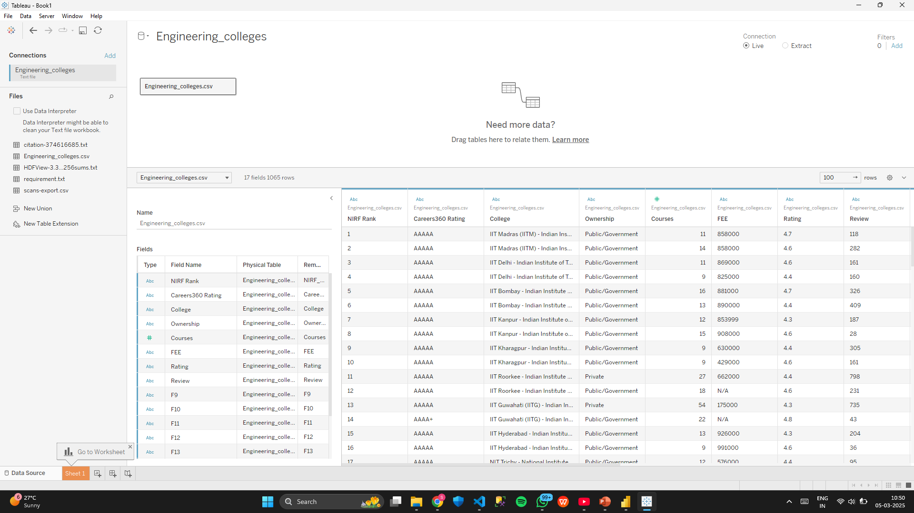
Data manipulation:
Data Manipulation is the process of changing or adjusting data to make it more organized and easier to read.
First we need to load the data into Tableau.
After that we need to go to Table view and add a new column named city.
In that column we will give college name,fees for all rows.

Slide 14
Preprocessing
1.Import Data:
Load Data: Import datasets related to engineering colleges from sources like Excel, CSV files, or SQL databases into Tableau.
Data Preview: Review the dataset in Tableau to understand its structure, including columns such as college name, location, fees, ratings, and courses offered.
2. Data Cleaning
Remove Duplicates: Eliminate any duplicate entries to ensure the dataset's integrity.
Handle Missing Values:
Remove Rows: If null values are minimal, consider excluding rows with missing data.
Replace Values: Fill missing fields using mean, median, or default values to maintain consistency.
Correct Errors: Rectify incorrect data entries or typos to enhance accuracy.

Slide 15
.
3. Data Transformation:
Change Data Types: Update data types where necessary (e.g., ensuring numerical values for fees or ratings).
Rename Columns: Assign meaningful column names to improve readability and align with the analysis objectives.
4.Data Visualization:
Leverage Tableau's features to create visualizations such as bar charts, heatmaps, and scatter plots to analyze trends, fee structures, and course popularity among engineering colleges.
Customize dashboards for an intuitive understanding of insights.

Slide 16
.
4. Filtering and Sorting
Filter Rows:
Use Tableau’s filter options to eliminate unnecessary data, such as colleges outside specific locations or fees beyond a certain range. This step ensures the dataset focuses on relevant information for analysis.
Sort Data:
Organize data by columns, such as ranking colleges based on ratings or arranging them by fee structure, to make the dataset more insightful and structured.
5. Save and Load Data
Save and Publish:
After completing data transformations, save the Tableau workbook and publish it to Tableau Server or Tableau Public for sharing and further analysis.

Slide 17
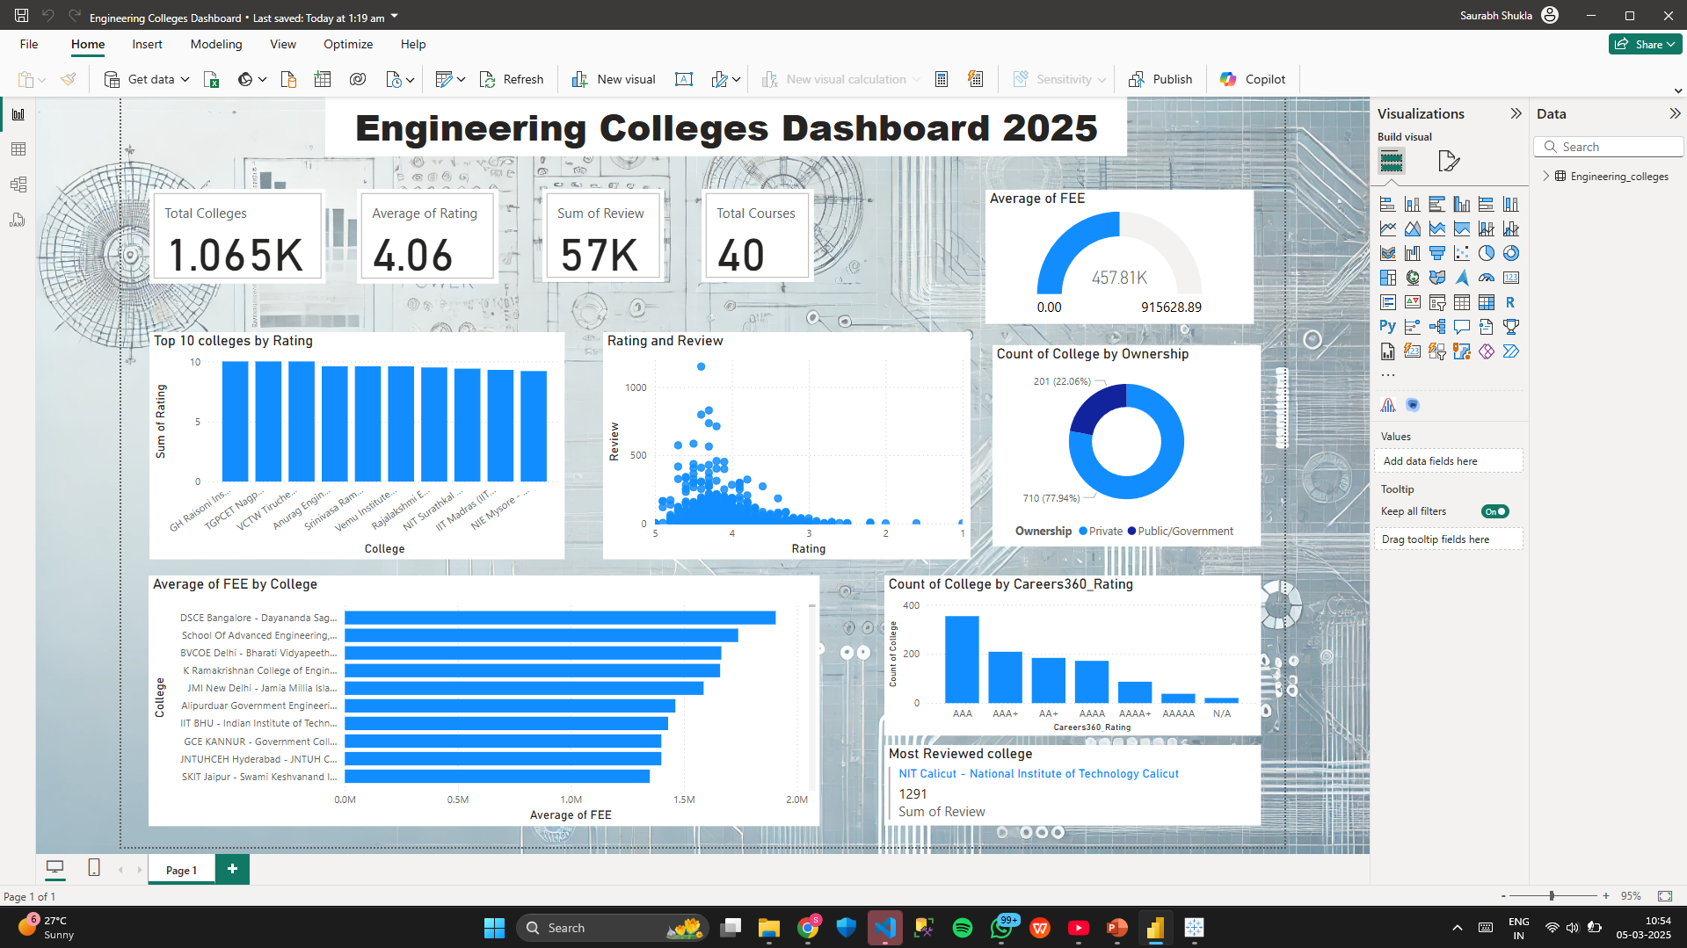
.

Slide 18
THANK YOU

